Slide 1
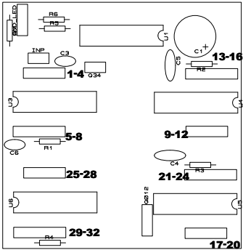
















GND LEDS
$$5 V$$
$$+ −$$
$$B4$$
$$B3$$
$$PLACA MUX$$
$$L3 L2 L1 L4$$
$$L13 L15 xx L16 L14$$
$$L5 L7 xx L8 L6$$
$$L11 L10 L9 L12$$
$$L27 L26 L25 L28$$
$$L21 L23xx L24 L22$$
$$B2$$
$$L29 L31xx L32 L30$$
$$B1$$
$$L19 L18 L17 L20$$
$$B0$$

Slide 2
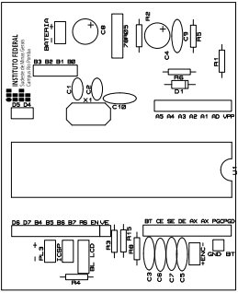



























$$LCD$$
$$D5 D4$$
$$LCD$$
$D6 D$7 B4
$$5V$$
$$MUX$$
$$MUX B3$$
$$− +$$
$MUX B$2
$$MUX B1$$
$$− +$$
$$Alimentação 8.4V$$
$$− +$$
$MUX B$0
$$− +$$
$$BL LCD$$
$$LCD$$
EN V0
$$PLACA$$
$$MCU$$
$$BOTÃO$$
$$CLK ENCODER$$
$$SW ENCODER$$
$$DT ENCODER$$
$$5V$$
$$+ −$$
$$GND BT$$
$$PGC$$
$$CONV. AD$$
$$PGD$$
$$VPP$$

